Slide 1
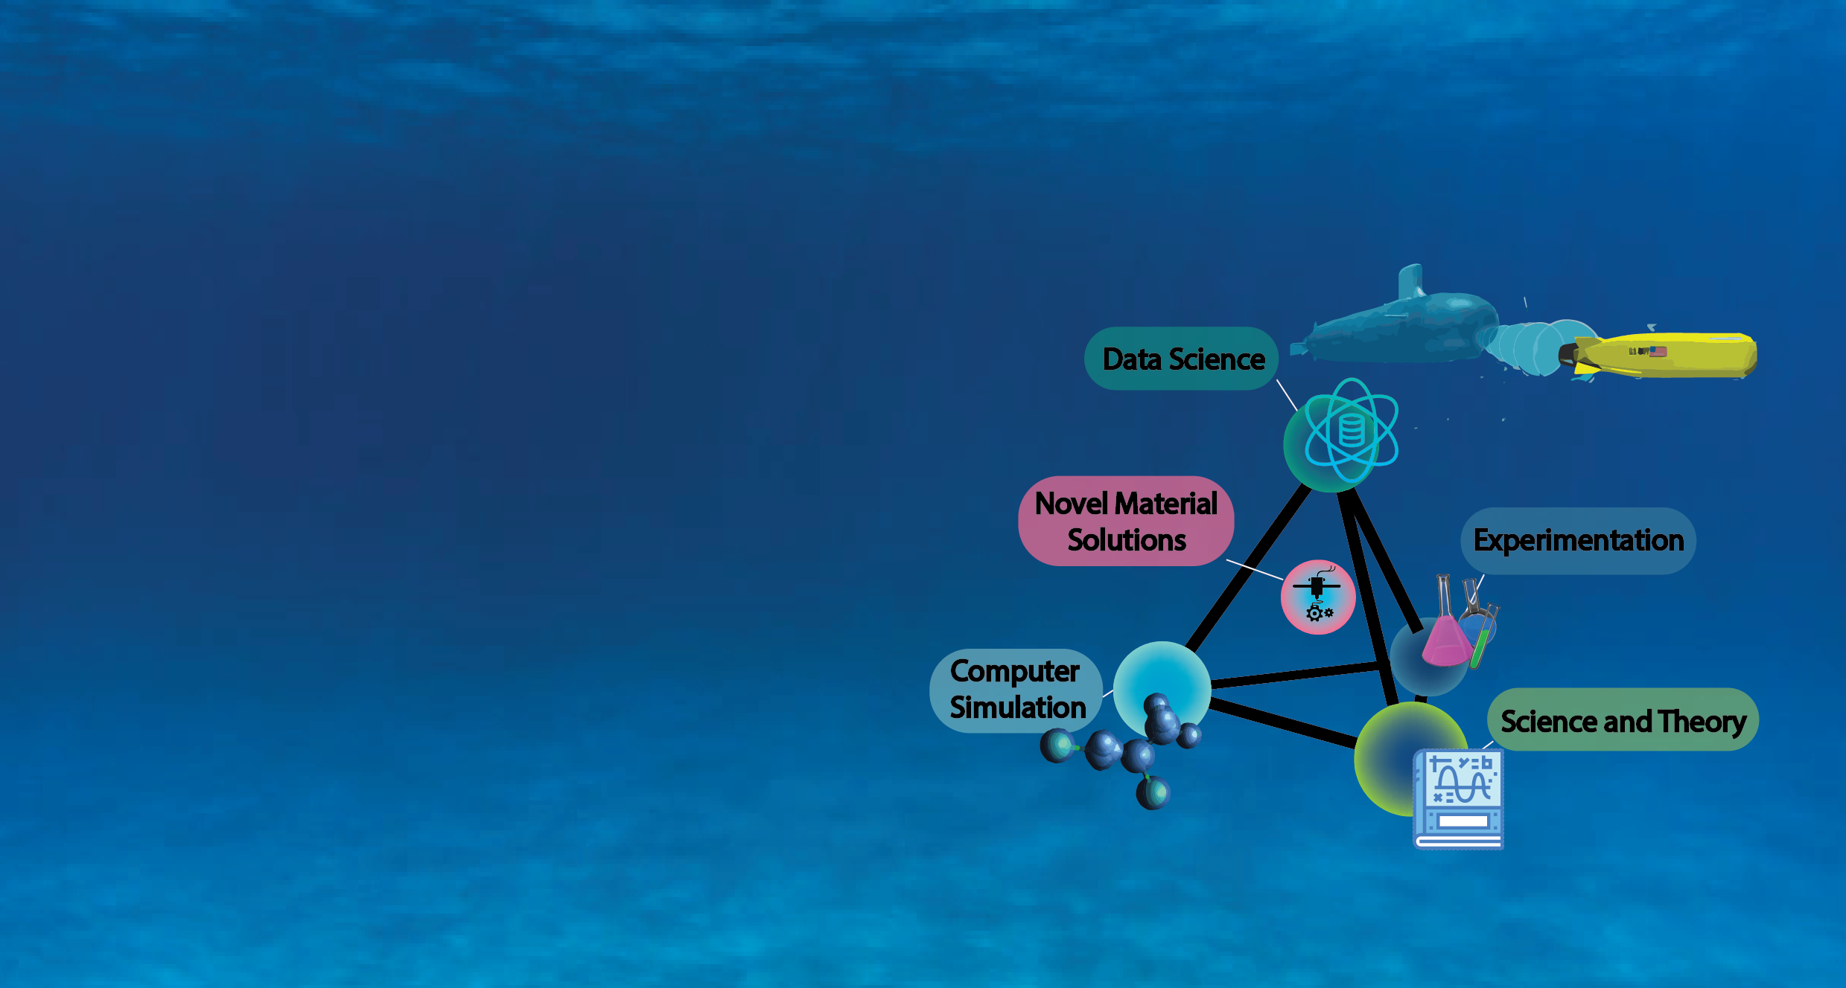

Intelligent Selection and Rational Co-Design of AM Polymers for Marine Applications
Carly Travis
Applied Masters Student
Materials Science and Engineering
University of Washington

Slide 2
Polymer co-design for FDM additive manufacturing
Goal: select + design thermoplastic materials for AM that will have superior resistance to marine degradation
Polymers have near-infinite chemical spaces and property variables, making “trial-and-error” approaches ineffective in covering all possibilities
Solution: data and simulation-driven approach to selection + design
Screen polymers/monomers within datasets based on property objectives
Model chains in simulated marine environments and extract data
Validate model via experiments with accelerated degradation protocol
Why: Reduce experimental time + resources
Accelerate materials development + Discover unique material solutions
Provide framework for future material needs

Slide 3
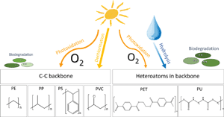
Polymer marine degradation mechanisms
Polymer degradation is influenced by chemical sequence
Changes at molecular level can reduce functionality of bulk structure (printed part)
Utilize data science to reveal molecular structure-property-performance trends influencing degradation through:
Datasets
Simulation
Validation
Influence of monomer structure on plastic degradation in marine environments
Chemical, structural, physical
Polymer Properties
Prediction + Selection
Degradation probability
Method

Slide 4
Specific aims for approach:
Aim 1
Aim 2
Aim 3
Aims +
Construct + screen property datasets to find best candidates
Supplemental Aims
Simulate best candidates to reveal molecular-scale degradation mechanisms
Validate and guide models via in-person experimentation
Incorporate additives (CF/chemical)
Model UV + biofilm mechanisms
Simulation-guided design for new properties (i.e. conductivity)
Screen candidates based on property objectives + reveal structure-property- performance trends
Uncover structure-property trends and predict when/why degradation occurs
Expose polymers to equivalent degradation environments in simulation and laboratory

Slide 5
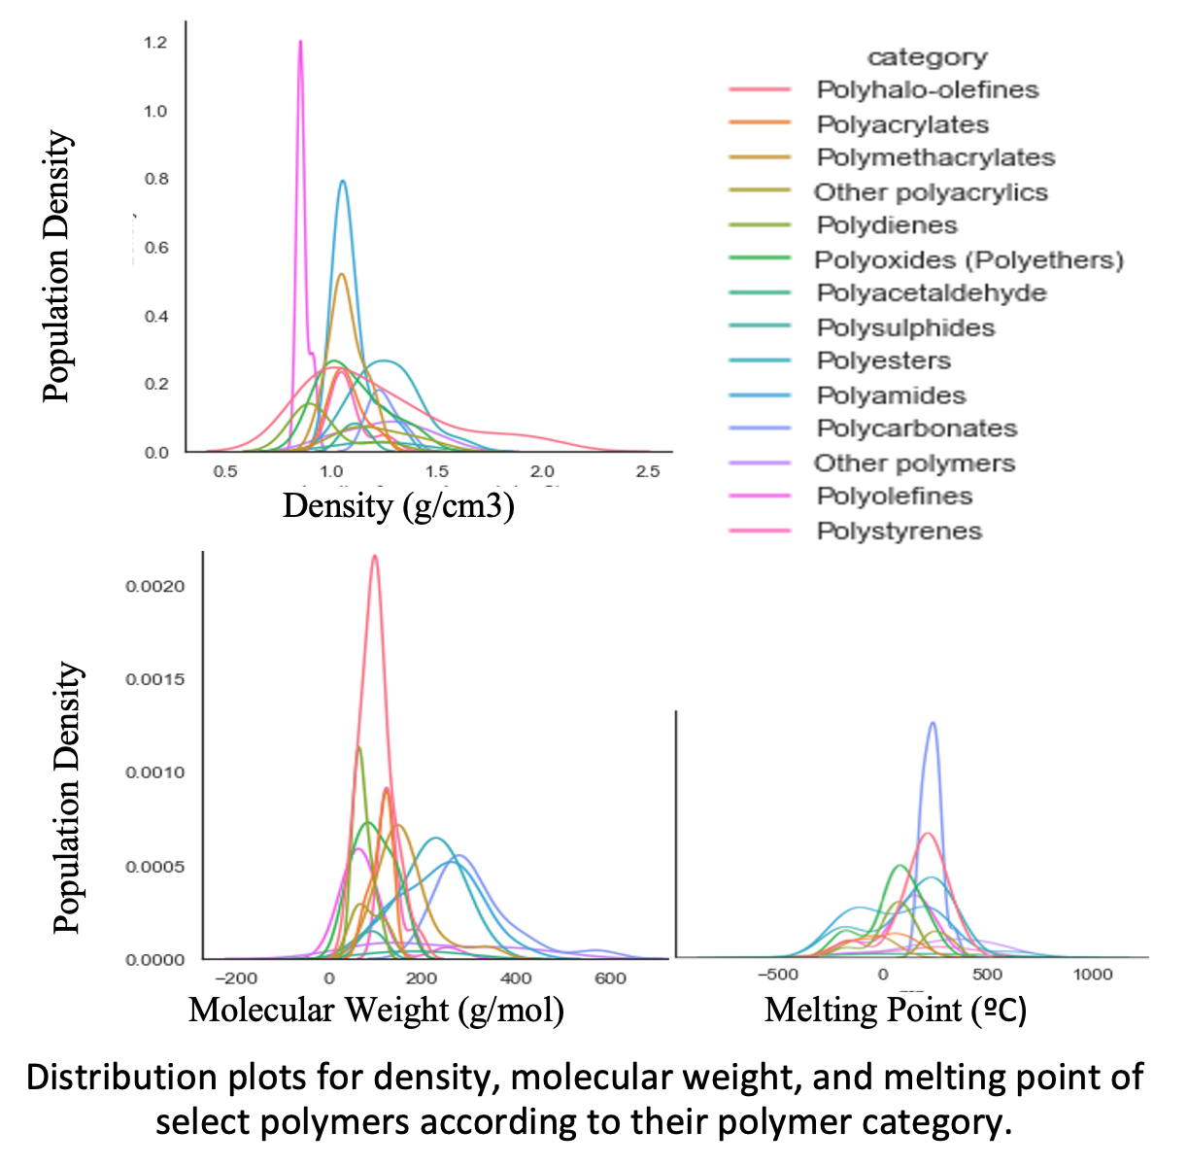
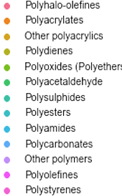
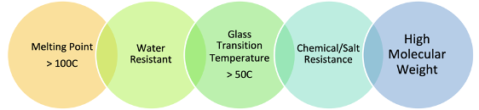
Aim 1 - Data science applied to polymer properties
Dataset constructed from multiple open-source sets of thermophysical property information
Organized according to monomer unit
Literature + theory-guided property selection of 5 general parameters for screening:
Aims to reveal structure-property trends in degradation and best candidates for AM

Slide 6
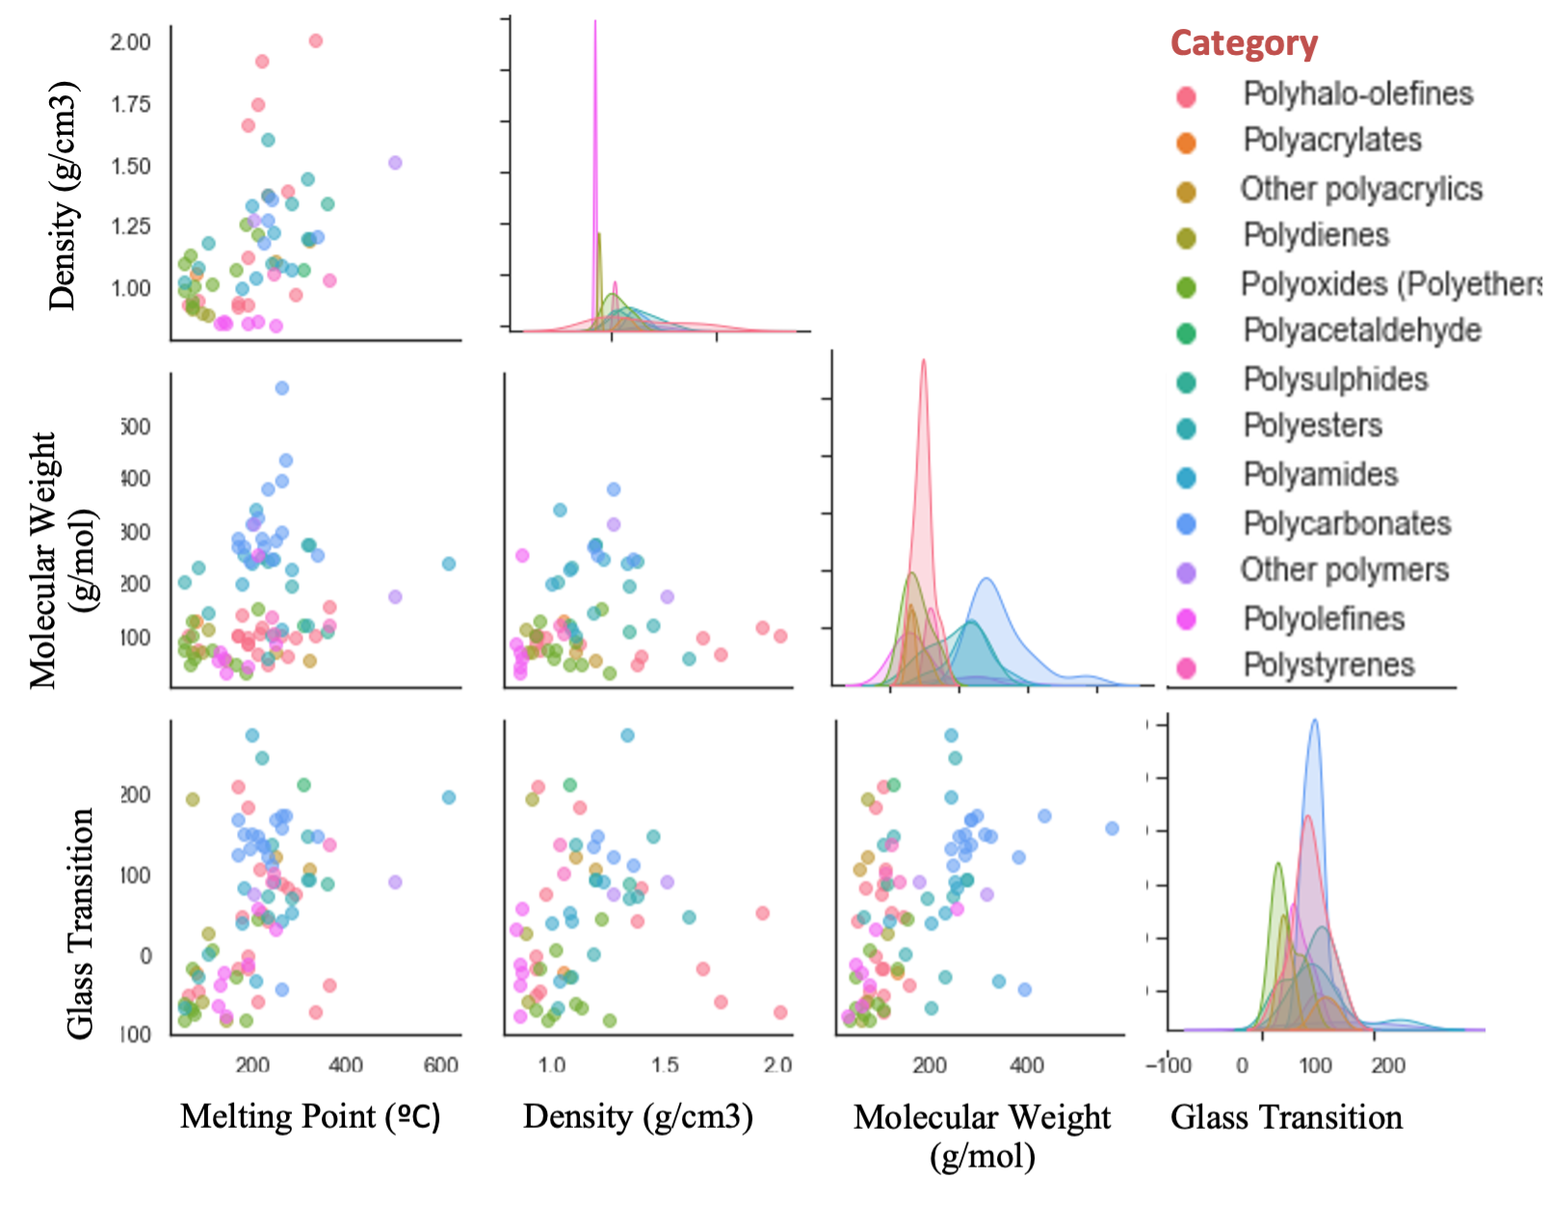
Aim 1 - Data science applied to polymer properties
Polymers with similar monomer structures tend to have similar property distributions
Distributions of density, molecular weight, melting temperature, and glass transition temperature data in the studied within dataset of interest for marine degradation. Correlation plots between different properties of interest for each category are modeled.

Slide 7
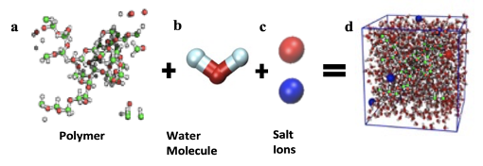
Aim - 2: Simulations of marine degradation - method
LAMMPS used for simulating marine degradation:
Polymer chain
Water molecules
3.5% salt ions
Set to accelerated degradation protocol used in laboratory
Temperatures range 20-70C
Duration of 2 and 4 weeks
Post-simulation results are compared to initial data to reveal extent of property change and the mechanisms by which they changed
Properties Evaluated in LAMMPS
Chemical Composition
Molecular Weight
Tg Tm
Density

Slide 8
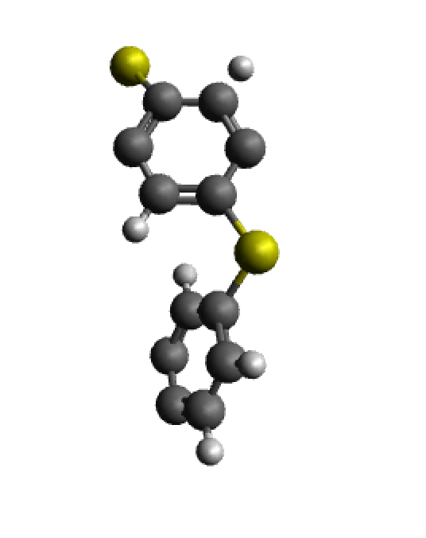
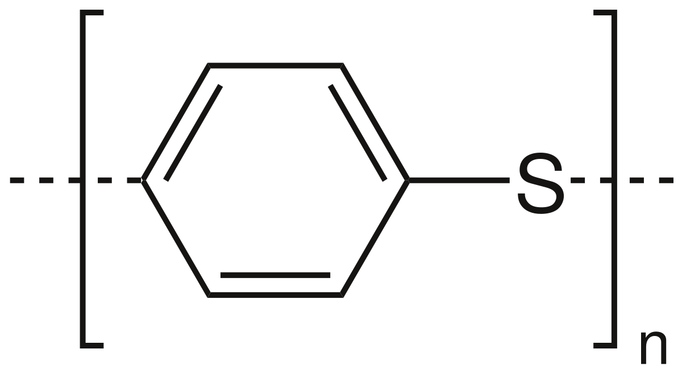
Aim 3 – Validate models through experimentation
Perform accelerated aging of AM polymers to guide and validate methods of Aim 1 and Aim 2.
Current work: Polyphenylene Sulfide (PPS)
Engineering AM polymer with excellent thermal and chemical stability
Experiment
Chemical composition via Raman
Thermal properties via TGA, DSC
Simulation
Chemical composition changes visualized
Density + volume used to approximate thermal properties
Bulk property change via tensile test
Water absorption via mass gain
Water absorption via surface area change
PPS monomer 2D to 3D representation, modeled in Avogadro for LAMMPS
Future candidates: ULTEM, Nylon (PA)

Slide 9
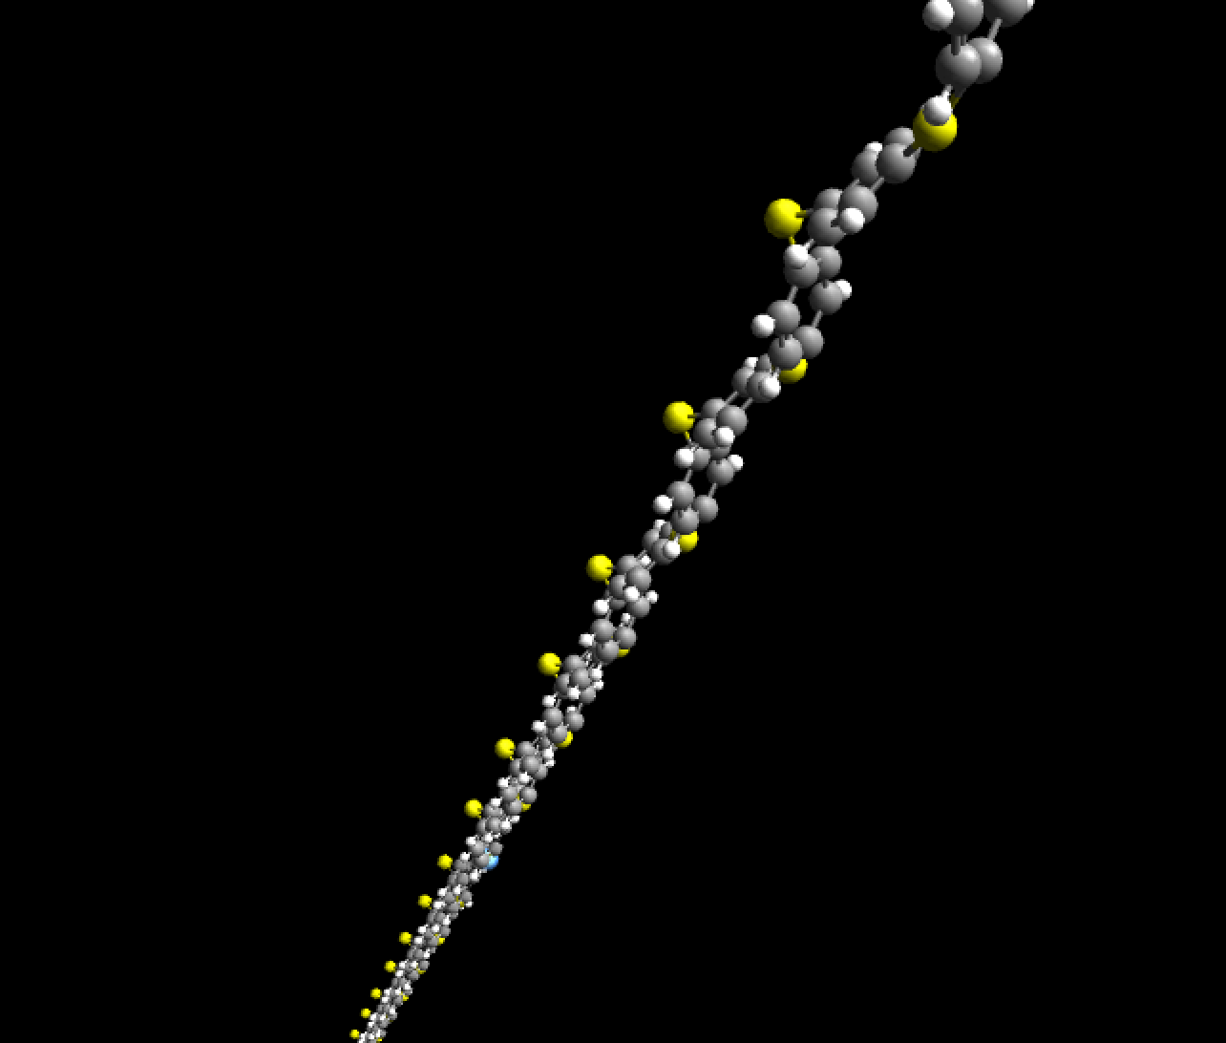
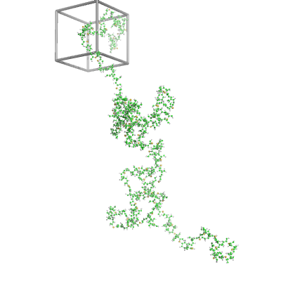
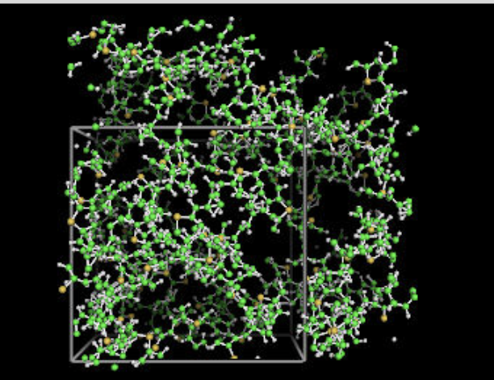
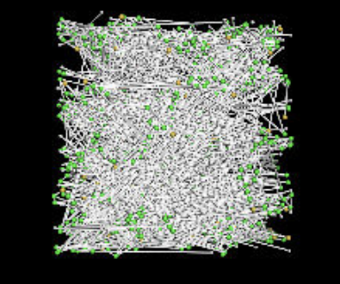
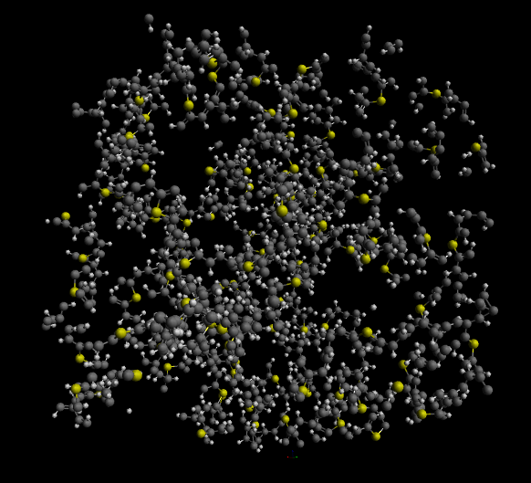
Building and modeling PPS simulation

Slide 10
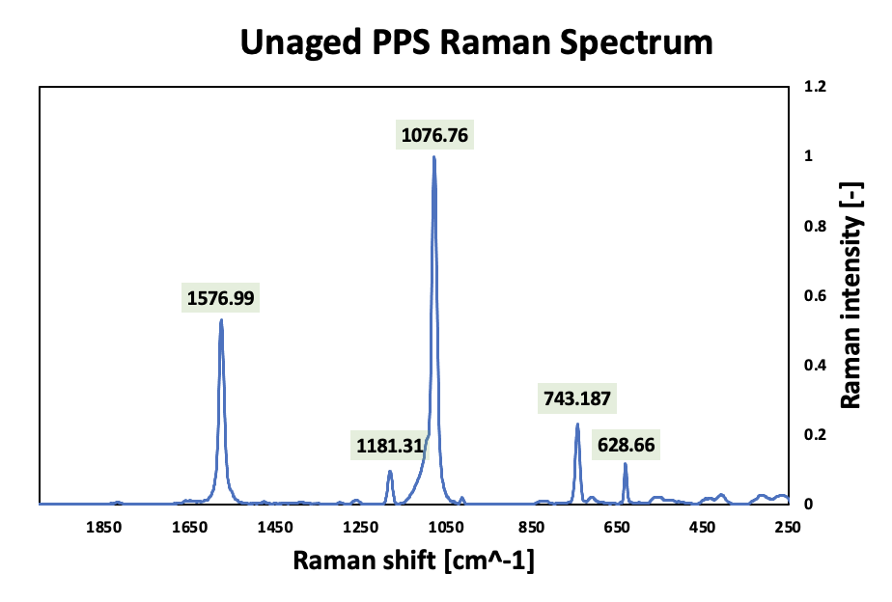
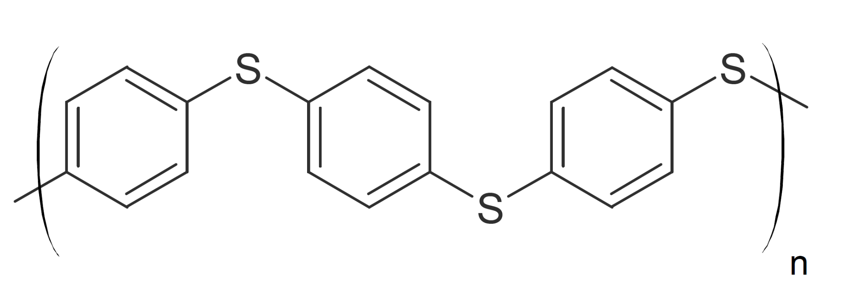
Validating unaged PPS composition via Raman
Peak [cm⁻¹] | Component
1577, 629 | C-C (phenyl)
1181 | C-H
1077 | C=CH (benzene)
743 | C-S

Slide 11
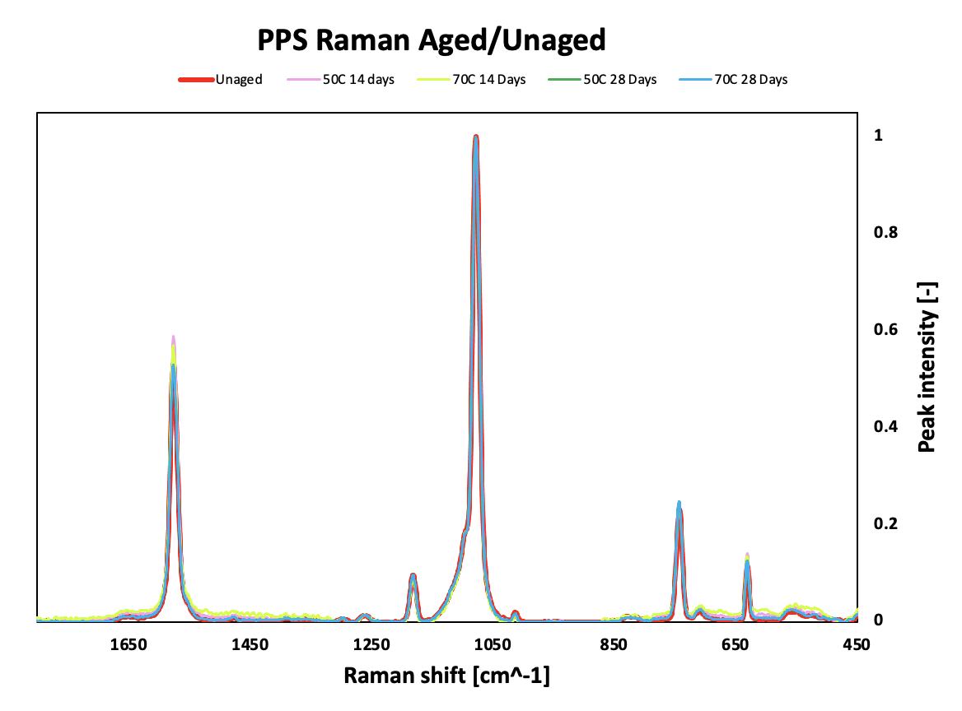
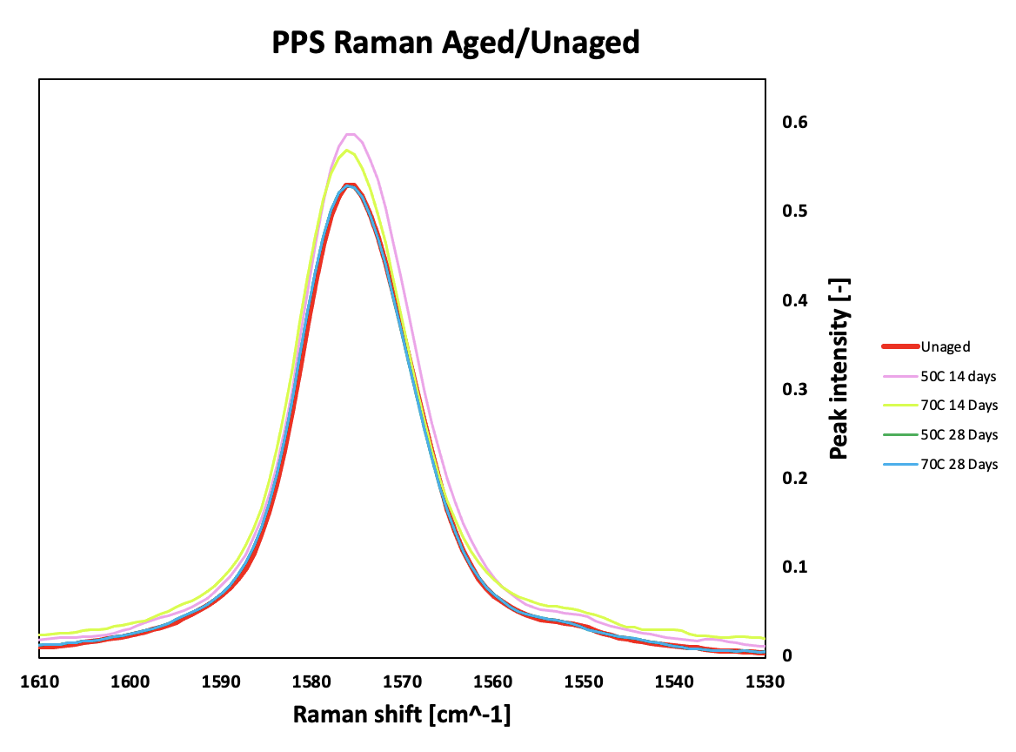
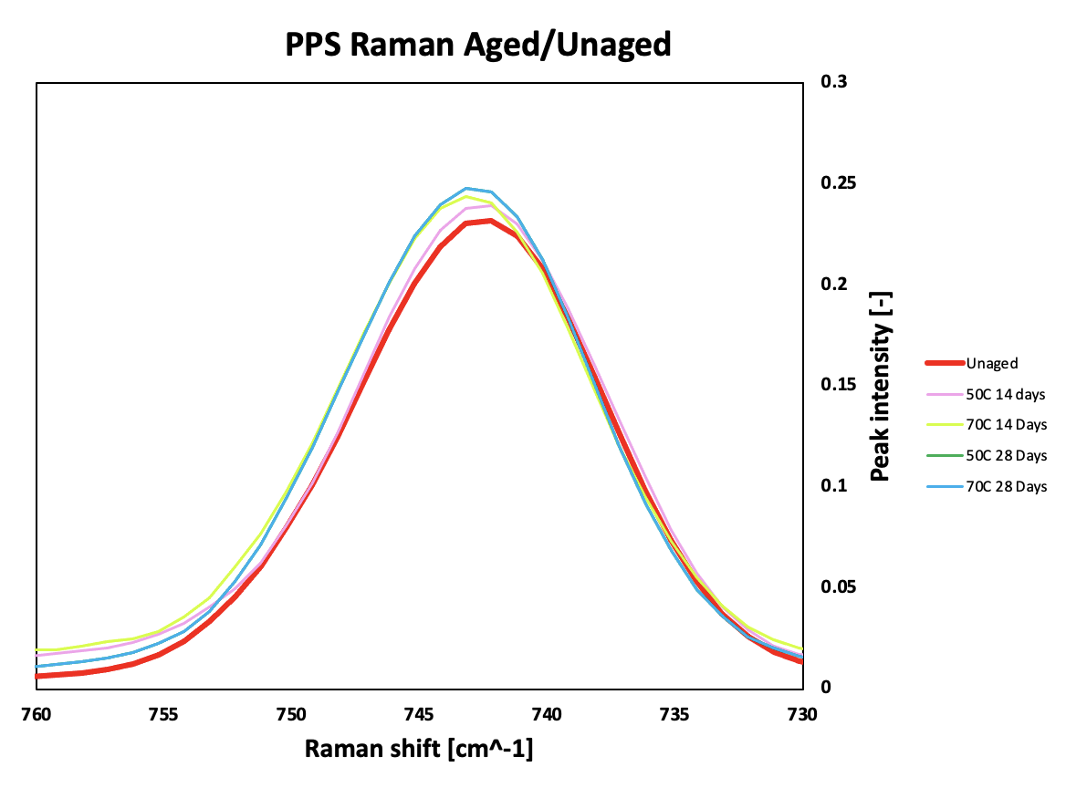
Validating PPS composition after aging
PPS aged in seawater at temperatures of 50, 70C for 14 and 28 days
Marine exposure at these temperatures has little influence on chemical composition over 14/28 day periods
Minor change for:
C-C phenyl group (1577 cm⁻¹)
C-S bonds (743 cm⁻¹)
No change for C=C benzene ring (1077 cm⁻¹)
We should expect to see minimal change in chemical groups during simulation

Slide 12
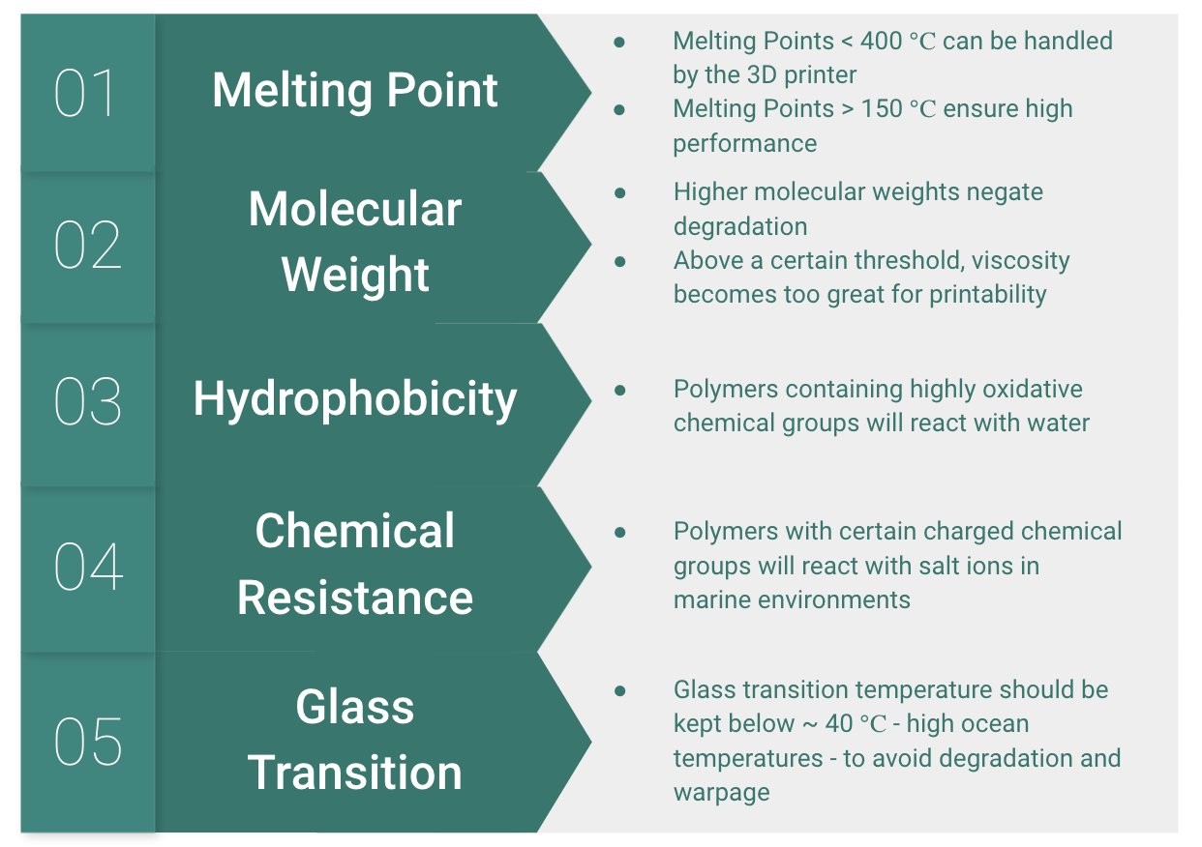

Slide 13
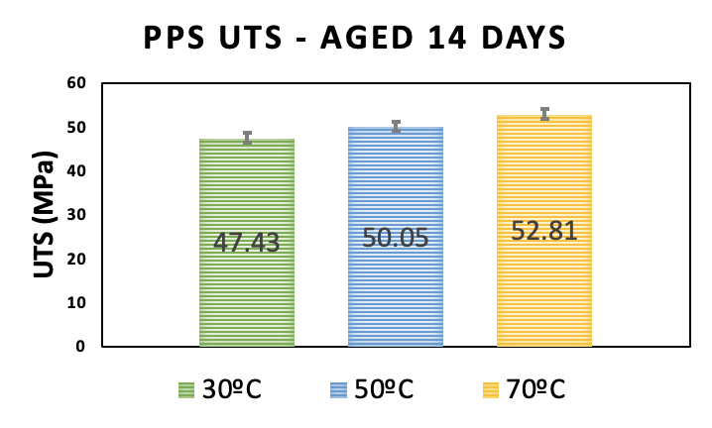
UTS - Aged 14 Days
Temp (℃) | 30 | 50 | 70
UTS (MPa) | 47.37 | 50.05 | 52.81
STDEV | 1.23 | 1.13 | 1.31

Slide 14
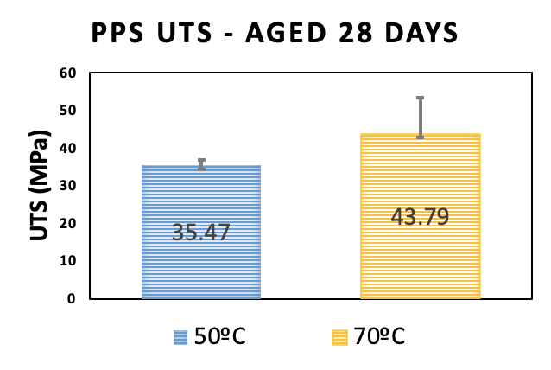
UTS - 28 Days
Temp (℃) | 50 | 70
UTS (MPa) | 35.47 | 43.79
STDEV | 1.41 | 9.56

Slide 15
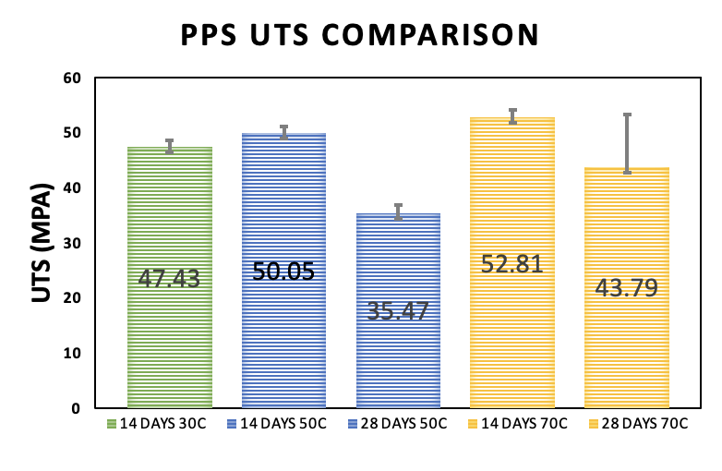
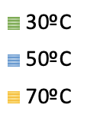
Overall Comparison UTS

Slide 16
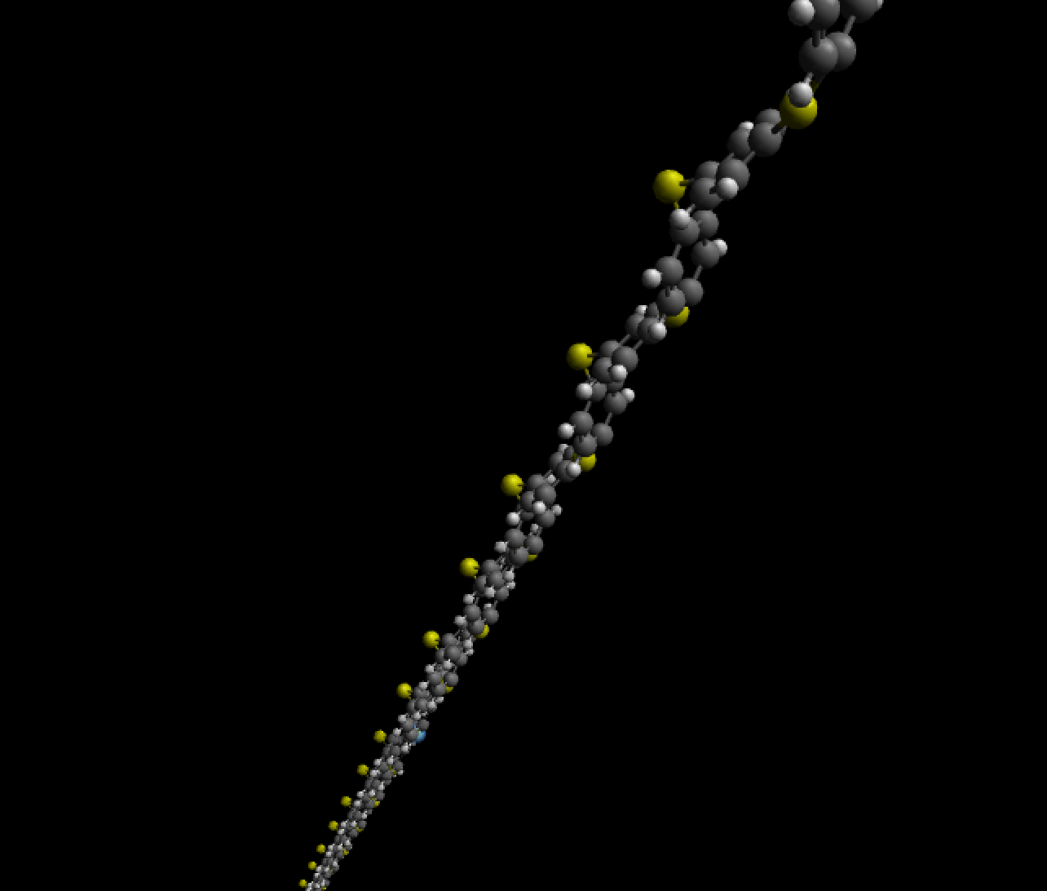
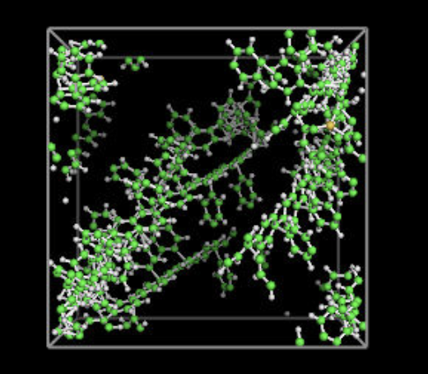
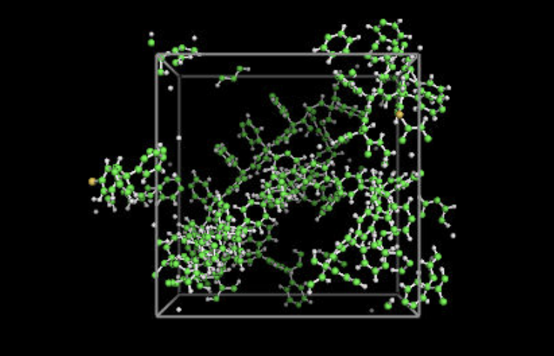
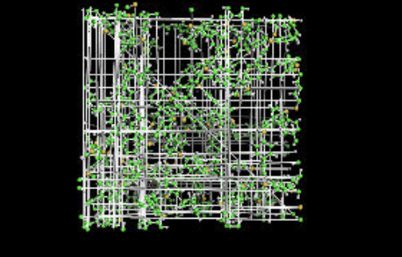

Slide 17
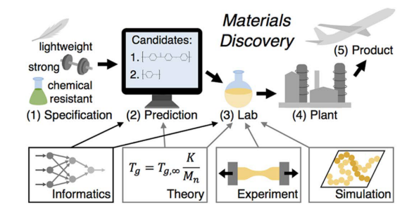

Slide 18
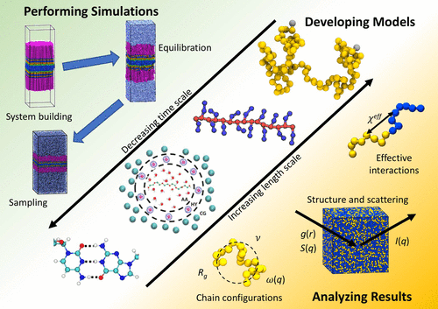
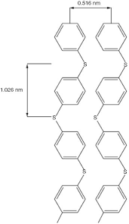
Relaxation Procedure

Slide 20
